Slide 1
Problem Statement Description :
LOWE’S HACKATHON
The current retail store in India are not automatic .The traditional method takes a lot of time.
Proposal is to device a solution that will automate the process and will help in saving time and human effort.
In present shopping system, searching a product is quite tiring, especially in large stores, and time consuming.
People has to wait in large queues due to manual checkouts and
The proposed solution includes just modifying the shopping cart trolley, rather than renovating the whole retail store.
PROBLEM STATEMENT : Build a solution to help customers find products in the store and help them navigate to the corresponding shelf.If there is a shopping list , provide the best shopping trip to complete the purchases.
PROBLEM STATEMENT No : 3
TEAM NAME : MILTON
TEAM LEADER NAME : ABHINAV RASTOGI

Slide 2
Automated Invoice Generation
NAVIGATION SYSTEM
The shopping list is synced with the app and user is notified when all items are available.
Each customer entering the mall issues a cart with the help of OTP received on the mobile app and the List of goods to be bought is automatically updated on the cart ‘s screen, along with the best available deals available on the product.
The customer will be navigated on the shortest possible route to collect all the Items mentioned in the list, via a navigation map, displayed on the screen present on the cart.
The navigation process includes various algorithms such as Travelling Salesman Algorithm, A* Algorithm.
-This has been done to make our shopping experience easy and less tiring.
-This automated checkout system will help avoid long queues while checking out and billing.
-The cart has an automatic inbuilt QR Scanner that scans the QR code of each and every product being put into the cart.
-The total value of the Cart is automatically generated.
-The payment is deducted from the customer’s account while checking out.
-Customer finally puts the cart into packaging unit, and gets the packaged products while checking out of the store.
TECHNOLOGY STACK:
Java Script
Python
Java
DBMS
NoSQL
RF ID Sensors
Navigation map.
Travelling salesman Algorithm.
A* Algorithm

Slide 3
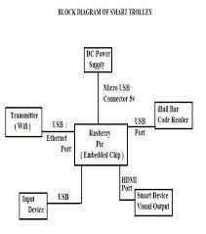
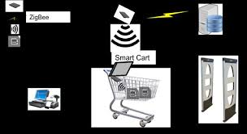
FLOW DIAGRAM

